Slide 1
Analog Communications
DR. KARNA VISHNU VARDHANA REDDY
Associate Professor
Department of Electronics and Communication Engineering
Aditya Engineering College (A)
Email: vishnuvardhanareddyk@aec.edu.in

Slide 2

Aditya Engineering College (A)
UNIT – I
Amplitude Modulation: Introduction to Fourier transform, Introduction to communication system, Need for modulation, Frequency Division Multiplexing, Amplitude Modulation, Time domain and Frequency domain description, Single tone modulation, Power relations in AM waves, Generation of AM waves: Square law Modulator, Switching modulator, Detection of AM Waves: Square law detector, Envelope detector, Related problems.

Slide 3
Aditya Engineering College (A)
The Communication Process
Communication provides the senses for ships on the high seas, aircraft in flight, and rockets and satellites in space.
Communication through a wireless telephone keeps a car driver in touch with the office or home miles away.
Communication keeps a weather forecaster informed of conditions measured by a multitude of sensors.
communication involves implicitly the transmission of information from one point to another through a succession of processes as described:

Slide 4
Aditya Engineering College (A)
The generation of a message signal
The description of the message signal by a set of symbols
The encoding of symbols suitable for transmission
The transmission of the encoded symbols to the desired destination
The decoding and reproduction of the original symbols
The recreation of the original signal

Slide 5
Aditya Engineering College (A)
Introduction to Communication System

Slide 6
Aditya Engineering College (A)
There are three basic element in a communication system, namely, transmitter, channel, and receiver.
The transmitter (Tr) is located at one point in space, the receiver (Rr) is located at some other point separate from the transmitter, and the channel is the physical medium that connects the Tr and Rr.
The purpose of the transmitter is to convert the message signal produced by the source of information into a form suitable for transmission over the channel.

Slide 7
Aditya Engineering College (A)
The transmitted signal propagates along the channel is distorted due to channel imperfections.
Moreover, noise and interfering signals are added to the channel output, with the result that the received signal is a corrupted version of the transmitted signal.
The receiver has the task of operating on the received signal so as to reconstruct a recognizable form of the original signal

Slide 8
Aditya Engineering College (A)
Need for Modulation
Increase the Signal Strength
The baseband signals transmitted by the sender are not capable of direct transmission. The strength of the message signal should be increased so that it can travel longer distances. This is where modulation is essential. The most vital need of modulation is to enhance the strength of the signal without affecting the parameters of the carrier signal.
Wireless Communication System
Modulation has removed the necessity for using wires in the communication systems. It is because modulation is widely used in transmitting signals from one location to another with faster speed. Thus, the modulation technique has helped in enhancing wireless communication systems.

Slide 9
Aditya Engineering College (A)
Prevention of Message Signal from Mixing
Modulation and its types prevent the interference of the message signal from other signals. It is because a person sending a message signal through the phone cannot tell such signals apart. As a result, they will interfere with each other. However, by using carrier signals having a high frequency, the mixing of the signals can be prevented. Thus, modulation ensures that the signals received by the receiver are entirely perfect.
Narrow Banding of Signal
An audio signal usually has a frequency range (20 Hz to 20 kHz), if it is directly transmitted then the ratio of highest to the lowest frequency becomes (20 kHz / 20 Hz) = 1000. But if this audio signal is modulated over a carrier signal of frequency 1000 kHz then the ratio of highest to the lowest frequency becomes:
(1000 kHz + 20 kHz) / (1000 kHz + 20 Hz) ≅ 1.2

Slide 10
Aditya Engineering College (A)
Size of the Antenna
The signals within 20 Hz to 20 kHz frequency range can travel only a few distances. To send the message signal, the length of the antenna should be a quarter wavelength of the used frequency. Thus, modulation is required to increase the frequency of the message signal and to enhance its strength to reach the receiver.
Length of the antenna can be easily calculated using this formula:
L = λ/4 = C/4f
= (3 x 10⁸) / 4f
Here, L = length of antenna
λ = wavelength of the transmitted signal
f = signal frequency

Slide 11
Aditya Engineering College (A)
The low-frequency message signal has a very high value of λ which will require a very high antenna (practically not possible).
For example: If we have to transmit a signal of 20 kHz then λ = C / f and length of the antenna L ≈ λ/4 where C is the wave velocity, here C = 3 × 10⁸ m/s.
L ≈ λ/4 = (3 × 10⁸) / 4(20 × 10³)
L = 3.75 km.
Frequency Multiplexing
It is practically not possible to distinguish between the different audio signals when transmitted simultaneously through a single antenna as all of them lie in the same spectral range. Hence, each of these signals is translated to a low-frequency range before transmission which makes it quite easier to recover them and distinguish each of them from one another at the receiver’s end.

Slide 12
Aditya Engineering College (A)
Frequency Division Multiplexing
Frequency-division multiplexing (FDM) divides the frequency spectrum of a higher bandwidth channel into many individual smaller bandwidth communication channels.
In FDM, signals of different frequencies are combined for concurrent transmission.
In FDM, the total bandwidth is divided to a set of frequency bands that do not overlap.
Each of these bands is a carrier of a different signal that is generated and modulated by one of the transmitting devices.
The frequency bands are separated from one another by strips of unused frequencies called the guard bands, to prevent overlapping of signals.

Slide 13
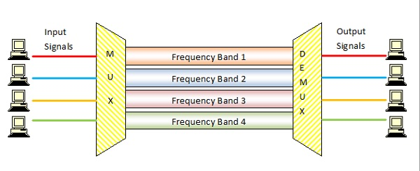
Aditya Engineering College (A)

Slide 14
Aditya Engineering College (A)
The modulated signals are combined together using a multiplexer (MUX) in the sending end.
The combined signal is transmitted over the communication channel, thus allowing multiple independent data streams to be transmitted simultaneously.
At the receiving end, the individual signals are extracted from the combined signal by the process of demultiplexing (DEMUX).
Consider four frequency bands, each with a known finite bandwidth of 150 kHz and separated by three guard bands of 10 kHz each.
To accommodate all the bands, the communication channel should have a capacity of (150 x 4) + (10 x 3) = 630 KHz.

Slide 15
Amplitude modulation
Aditya Engineering College (A)
Time-domain Description:
Consider a sinusoidal carrier wave c(t) defined by
where Ac is the carrier amplitude and fc is the carrier frequency. The information-bearing signal or message signal is denoted by m(t).
Amplitude modulation (AM) is formally defined as a process in which the amplitude of the carrier wave c(t) is varied about a mean value, linearly with the message signal m(t).
An amplitude-modulated (AM) wave may thus be described as a function of time as follows:
where ka is a constant called the amplitude sensitivity of the modulator responsible for the generation of the modulated signal s(t). Typically, the carrier amplitude Ac and the message signal m(t) are measured in volts, in which case the amplitude sensitivity k is measured in volt⁻¹.
In amplitude modulation, information pertaining to the message signal m(t) resides solely in the envelope, which is defined as the amplitude of the modulated wave s(t)—that is, Ac ⎸1+ k_{a} m(t) ⎸.

Slide 16
Aditya Engineering College (A)
the envelope of s(t) has essentially the same shape as the message signal m(t) provided that two conditions are satisfied:
1. The amplitude of k_{a} m(t) is always less than unity; that is, ⎸k_{a} m(t) ⎸< 1, for all t
it ensures that the function 1 + k_{a} m(t) is always positive, in which case we may express the envelope of the AM wave s(t), simply as Ac [1+ k_{a} m(t)].
When the amplitude sensitivity k_{a} of the modulator is large enough to make ⎸k_{a} m(t) ⎸ > 1 for any t, the carrier wave becomes over modulated, resulting in carrier phase reversals whenever the factor 1+ k_{a} m(t) crosses zero. The modulated wave then exhibits envelope distortion.
2. The carrier frequency f_{c} is much greater than the highest frequency component W of the message signal m(t)—that is, f_{c} >> W; W is the message bandwidth.

Slide 17
Aditya Engineering College (A)

Slide 18
Aditya Engineering College (A)
Frequency-domain Description:
Let m(t) ⇋ M(f ), where the Fourier transform M(f ) is called the message spectrum. The Fourier transform or spectrum of the AM wave s(t) is given by
where we used the relations
Suppose that the message signal m(t) is band-limited to the interval -W ≤ f ≤ W, as in Fig. (a) below.
the spectrum S(f) of the AM wave is as shown in Fig. (b) for the case when f_{c} > W.
This spectrum consists of two delta functions weighted by the factor A_{c}/2 and occurring at ± f_{c}, and two versions of the message spectrum translated in frequency by ±f_{c} and scaled in amplitude by (k_{a} A_{c})/2.

Slide 19
Aditya Engineering College (A)

Slide 20
Aditya Engineering College (A)
Three important observations:
As a result of the modulation process, the spectrum of the message signal m(t) for negative frequencies extending from -W to 0 becomes completely visible for positive (i.e., measurable) frequencies, provided that the carrier frequency satisfies the condition f_{c} > W.
For positive frequencies, the portion of the spectrum of an AM wave lying above the carrier frequency f_{c} is referred to as the upper sideband, whereas the symmetric portion below f_{c} is referred to as the lower sideband. The condition f_{c} > W ensures that the sidebands do not overlap.
For positive frequencies, the highest frequency component of the AM wave equals f_{c} + W, and the lowest frequency component equals f_{c} - W. The difference between these two frequencies defines the transmission bandwidth B_{T} of the AM wave, which is exactly twice the message bandwidth W; that is, B_{T} = 2W.

Slide 21
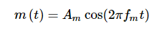
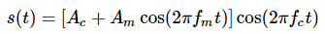
Single tone modulation
Aditya Engineering College (A)
Message signal is
Carrier signal is
where,
A_{m} and A_{c} are the amplitude of the modulating signal and the carrier signal respectively.
f_{m} and f_{c} are the frequency of the modulating signal and the carrier signal respectively.
Then, the equation of Amplitude Modulated wave will be

Slide 22
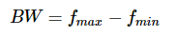
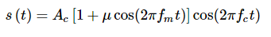
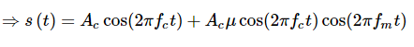
Bandwidth
Aditya Engineering College (A)
Bandwidth (BW) is the difference between the highest and lowest frequencies of the signal. Mathematically, we can write it as
Consider the following equation of amplitude modulated wave.
Hence, the amplitude modulated wave has three frequencies. Those are carrier frequency f_{c}, upper sideband frequency f_{c}+f_{m} and lower sideband frequency f_{c}−f_{m}

Slide 23
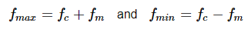
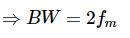
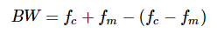
Aditya Engineering College (A)
Here,
Substitute, f_{max} and f_{min} values in bandwidth formula.
Thus, it can be said that the bandwidth required for amplitude modulated wave is twice the frequency of the modulating signal.

Slide 24
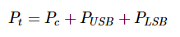
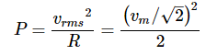
Power relations in AM waves
Aditya Engineering College (A)
Consider the following equation of amplitude modulated wave.
Power of AM wave is equal to the sum of powers of carrier, upper sideband, and lower sideband frequency components.
We know that the standard formula for power of cos signal is

Slide 25
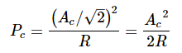
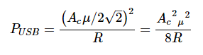
Aditya Engineering College (A)
Where,
V_{rms} is the rms value of cos signal.
V_{m} is the peak value of cos signal.
First, let us find the powers of the carrier, the upper and lower sideband one by one.
Carrier power
Upper sideband power

Slide 26
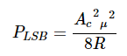
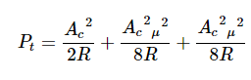
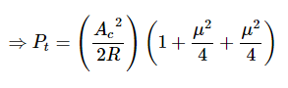
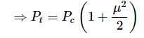
Aditya Engineering College (A)
Similarly, we will get the lower sideband power same as that of the upper side band power.
Now, let us add these three powers in order to get the power of AM wave.
If the modulation index μ=1 then the power of AM wave is equal to 1.5 times the carrier power. So, the power required for transmitting an AM wave is 1.5 times the carrier power for a perfect modulation.
Notes:
Mew=modulation index

Slide 27
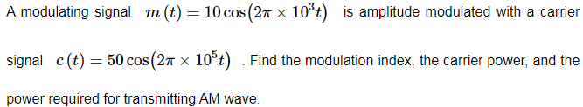
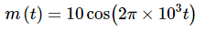
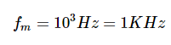
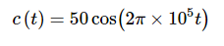
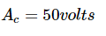
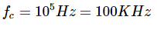
Problems
Aditya Engineering College (A)
Given, the equation of modulating signal as
We know the standard equation of modulating signal as

Slide 28
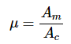
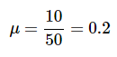
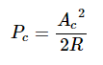
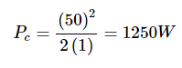
Aditya Engineering College (A)
We know the formula for modulation index as
Therefore, the value of modulation index is 0.2 and percentage of modulation is 20%.
The formula for Carrier power,

Slide 29
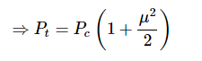
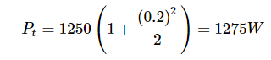
Aditya Engineering College (A)
We know the formula for power required for transmitting AM wave is
Therefore, the power required for transmitting AM wave is 1275 watts.

Slide 30
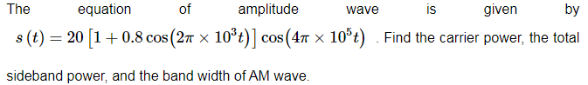
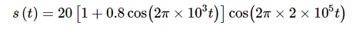
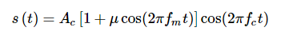
Aditya Engineering College (A)

Slide 31
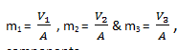
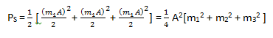
Multi-tone amplitude modulation
Aditya Engineering College (A)

Slide 32
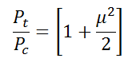
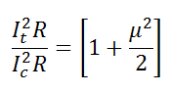
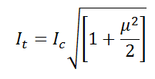
Current relations
Aditya Engineering College (A)
The formula for power required for transmitting AM wave is

Slide 33
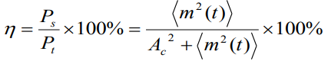
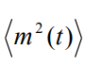
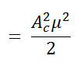
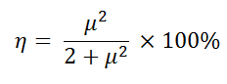
Efficiency
Aditya Engineering College (A)
The % of the total power carried out by the sidebands is η, given by

Slide 34
Efficiency
Aditya Engineering College (A)
Determine η and the percentage of the total power carried out by the sidebands of the AM wave for tone modulation when (1) μ = 0.5 and (2) μ = 0.3.
ANS:
a: 11.11%
a: 4.3%
A 400-watt (400-W) carrier is modulated to a depth of 75%. Calculate the total power in the modulated wave.
ANS: 512.5W
A broadcast radio transmitter radiates 10 kilowatts (10 kW) when the modulation percentage is 60. How much of this is carrier power?
ANS: 8.47kW

Slide 35
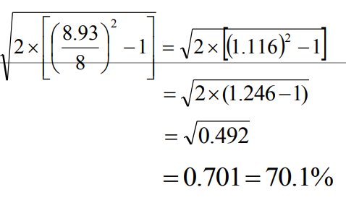
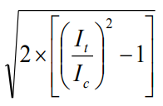
Aditya Engineering College (A)
The antenna current of an AM transmitter is 8 amperes (8 A) when only the carrier is sent, but it increases to 8.93 A when the carrier is modulated by a single sine wave. Find the percentage modulation. Determine the antenna current when the depth of modulation changes to 0.8.
μ = =

Slide 36
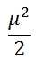
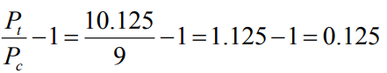
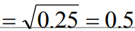
Aditya Engineering College (A)
A certain transmitter radiates 9 kW with the carrier un-modulated and 10.125 kW when the carrier is sinusoidally modulated. Calculate the modulation index. If another sine wave, corresponding to 40 percent modulation, is transmitted simultaneously, determine the total radiated power.
=
μ

Slide 37
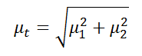
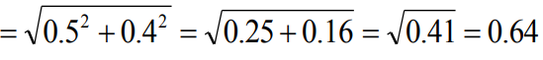
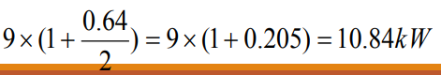
Aditya Engineering College (A)
We know the formula for power required for transmitting AM wave is
=

Slide 38
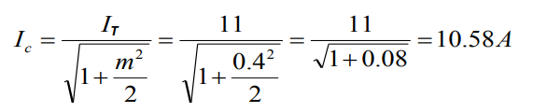


Aditya Engineering College (A)
The antenna current of an AM broadcast transmitter, modulated to a depth of 40 percent by an audio sine wave, is 11 A. It increases to 12 A as a result of simultaneous modulation by another audio sine wave. What is the modulation index due to this second wave?

Slide 39
Generation of AM waves
Aditya Engineering College (A)
In this chapter, let us discuss about the modulators, which generate amplitude modulated wave. The following two modulators generate AM wave.
Square law modulator
Switching modulator

Slide 40

Square law modulator
Aditya Engineering College (A)
Following is the block diagram of the square law modulator
Let the modulating and carrier signals be denoted as m(t) and A_{c} cos(2πf_{c}t) respectively.

Slide 41

Square law modulator
Aditya Engineering College (A)
Following is the circuit diagram of the square law modulator

Slide 42


Aditya Engineering College (A)
These two signals are applied as inputs to the summer (adder) block. This summer block produces an output, which is the addition of the modulating and the carrier signal.
Mathematically, we can write it as
This signal V1t is applied as an input to a nonlinear device. The characteristics of the diode are closely related to square law.
Where, k₁ and k₂ are constants.

Slide 43

Aditya Engineering College (A)

Slide 44

Aditya Engineering College (A)
The last term of the above equation represents the desired AM wave and the first three terms of the above equation are unwanted.
So, with the help of band pass filter, we can pass only AM wave and eliminate the first three terms.
Therefore, the output of square law modulator is

Slide 45


Aditya Engineering College (A)
The standard equation of AM wave is
Where, Ka is the amplitude sensitivity
By comparing the output of the square law modulator with the standard equation of AM wave, we will get the scaling factor as k1 and the amplitude sensitivity kaka as 2(k2/k1)

Slide 46

Switching modulator
Aditya Engineering College (A)
Following is the circuit diagram of the square law modulator

Slide 47

Aditya Engineering College (A)
Let the modulating and carrier signals be denoted as m(t) and c(t)=A_{c} cos(2πf_{c}t) respectively.
Summer block produces an output mathematically, we can write it as
This signal V₁(t) is applied as an input of diode.
Assume, the magnitude of the modulating signal is very small when compared to the amplitude of carrier signal Ac.

Slide 48



Aditya Engineering College (A)
So, the diode’s ON and OFF action is controlled by carrier signal c(t)
This means, the diode will be forward biased when c(t)>0 and it will be reverse biased when c(t) < 0
We can approximate this as

Slide 49


Aditya Engineering College (A)
Where, x(t) is a periodic pulse train with time period
T=1/f_{c}
The Fourier series representation of this periodic pulse train is

Slide 50

Aditya Engineering College (A)

Slide 51

Aditya Engineering College (A)
The 1st term of the above equation represents the desired AM wave and the remaining terms are unwanted terms.
Thus, with the help of band pass filter, we can pass only AM wave and eliminate the remaining terms.
Therefore, the output of switching modulator is

Slide 52

Aditya Engineering College (A)
We know the standard equation of AM wave is
Where, ka is the amplitude sensitivity.
By comparing the output of the switching modulator with the standard equation of AM wave, we will get the scaling factor as 0.5 and amplitude sensitivity k_{a} as 4/πA_{c} .

Slide 53

Detection of AM Waves
Aditya Engineering College (A)
The process of recovering the message signal from the received modulated signal is known as demodulation . This process of detection is exactly opposite to that of modulation .

Slide 54
Detection of AM Waves
Aditya Engineering College (A)
The process of extracting an original message signal from the modulated wave is known as detection or demodulation.
The circuit, which demodulates the modulated wave is known as the demodulator.
The following demodulators (detectors) are used for demodulating AM wave.
Square Law Demodulator
Envelope Detector

Slide 55

Square Law Demodulator
Aditya Engineering College (A)
Square law demodulator is used to demodulate low level AM wave. Following is the block diagram of the square law demodulator.

Slide 56

Detection of AM Waves
Aditya Engineering College (A)
This demodulator contains a square law device and low pass filter. The AM wave V₁(t) is applied as an input to this demodulator.

Slide 57



Aditya Engineering College (A)
The standard form of AM wave is
We know that the mathematical relationship between the input and the output of square law device is

Slide 58

Aditya Engineering College (A)

Slide 59



Detection of AM Waves
Aditya Engineering College (A)
In the above equation, the term is the scaled version of the message signal. It can be extracted by passing the above signal through a low pass filter and the DC component can be eliminated with the help of a coupling capacitor.

Slide 60

Envelope Detector
Aditya Engineering College (A)
Envelope detector is used to detect (demodulate) high level AM wave. Following is the block diagram of the envelope detector. It is a simple and highly effective, provided that two practical conditions are satisfied:
1. The AM wave is narrowband, which means that the carrier frequency is large compared to the message bandwidth.
2. The percentage modulation in the AM wave is less than 100 percent.

Slide 61

Detection of AM Waves
Aditya Engineering College (A)
The circuit diagram of the envelope demodulator is shown in figure.
The circuit consists of a diode and resistor-capacitor (RC) filter.

Slide 62
Aditya Engineering College (A)
The standard AM wave is applied at the input of the demodulator .
On a positive half-cycle of the input signal, the diode is forward-biased and the capacitor C charges up rapidly to the peak value of the input signal.
When the input signal falls below this value, the diode becomes reverse-biased and the capacitor C discharges slowly through the load resistor R_{l} .
The discharging process continues until the next positive half-cycle.
When the input signal becomes greater than the voltage across the capacitor, the diode conducts again and the process is repeated.

Slide 63
Aditya Engineering College (A)
Assume that the diode is ideal, presenting resistance r_{f} to current flow in the forward-biased region and infinite resistance in the reverse-biased region.
Further assume that the AM wave applied to the envelope detector is supplied by a voltage source of internal impedance R_{s} .
The charging time constant (r_{f} + R_{s}) C must be short compared with the carrier period 1/f_{c}—that is,
So that the capacitor C charges rapidly and thereby follows the applied voltage up to the positive peak when the diode is conducting.
On the other hand, the discharging time constant R_{l}C must be long enough to ensure that the capacitor discharges slowly through the load resistor R_{l} between positive peaks of the carrier wave, that is,
where W is the message bandwidth. The result is that the capacitor voltage or detector output is nearly the same as the envelope of the AM wave

Slide 64
Aditya Engineering College (A)
AM wave input
Envelope detector output
Notice that the envelope detector output includes a high-frequency ripple; this ripple can be removed by using a low-pass filter

Slide 65

Detection of AM Waves
Aditya Engineering College (A)
The circuit diagram of the envelope demodulator is shown in figure

Slide 66

Detection of AM Waves
Aditya Engineering College (A)
There are two types of distortions which can occur in the detector output such as :
Diagonal clipping
Negative peak clipping
Diagonal Clipping
This type of distortion occurs when the RC time constant of the load circuit is too long. Due to this, the RC circuit cannot follow the fast changes in the modulating envelope . The diagonal clipping is shown in fig. 5 .

Slide 67

Detection of AM Waves
Aditya Engineering College (A)
Negative Peak Clipping
This distortion occurs due to a fact that the modulation index on the output side of the detector is higher than that on its input side.
Hence, at higher depth of modulation of the transmitted signal, the over modulation may takes place at the output of the detector.
The negative peak clipping will take place as a result of this over modulation as shown in fig

Slide 68

Problems
Aditya Engineering College (A)

Slide 69


Aditya Engineering College (A)

Slide 70

Aditya Engineering College (A)

Slide 71

Aditya Engineering College (A)

Slide 72

Aditya Engineering College (A)

Slide 73

Aditya Engineering College (A)

Slide 74

Aditya Engineering College (A)

Slide 75

Aditya Engineering College (A)

Slide 76

Aditya Engineering College (A)

Slide 77








Aditya Engineering College (A)
An antenna has an impedance of 40Ω. An un modulated AM signal produces a current of 4.8 A. The percentage modulation is 90%
a) The carrier power b) Total power c) Sideband Power
Ic = 4.8A, R = 40 ohms, μ % = 90%

Slide 78
Aditya Engineering College (A)
The output of an AM modulator is S(t)=5cos(1800πt)+20cos(2000πt) +5cos(2200πt) a) Determine the message signal m(t) and carrier signal c(t)
b) Determine the modulation index
c) Determine the modulation efficiency
d) Determine the ratio of power in side bands to the power in carrier.
COS(A+B)+COS(A-B) = 2COSA COSB
S(t) = 20cos(2000πt) + 5*2 (cos(200 πt) cos(2000 πt))
S(t) = 20{1 + (1/2) (cos(200 πt) }cos(2000 πt))

Slide 79
Detection of AM Waves
Aditya Engineering College (A)
The circuit diagram of the envelope demodulator is shown in figure

Slide 80
Detection of AM Waves
Aditya Engineering College (A)
The circuit diagram of the envelope demodulator is shown in figure

Slide 81
Detection of AM Waves
Aditya Engineering College (A)
The circuit diagram of the envelope demodulator is shown in figure

